Slide 1
Project 3: Soccer Transfer Fee Analysis
Phase 1 & 2
Team Lorenzo：Yang Lu, Xinyu (April) Liang, Yinghan Liu, Mi Zhong, Jie Chen,
Cheng Zhang, Cheng Chen, Hangyu Zhou
ALLPPT.com _ Free PowerPoint Templates, Diagrams and Charts

Slide 2
Business Goal
Predict the future transfer fee!
Figure out the pattern in club-to-club and league-to-league transfer
Build models to evaluate reasonable transfer fee based on club, league, transfer period and player’s profile
Provide predicted transfer price for clubs

Slide 3
Data Collection
Data Resources
http://www.transfermarkt.com (Actual transfer fee that happens, players has been transferred, leagues’ market value, clubs’ market value etc.,)
http://www.pesmaster.com/pes-2017/search/?myclub=yes (Profile of players)
http://pesdb.net/pes2017/ (backup Resource)
4 tables: Player’s Profile, Clubs’ table, Leagues’ table, Transfer table

Slide 4
Variable
Dependent Variable：
Transfer Fee
Independent Variable：
Player, Position, Position Summary, Transfer From(Club), Transfer From(League), Club Rate, League Rate, Transfer to(Club), Transfer to(League), Transfer Period
Age, Height, Overall rating, Pass, Shot, Physical Contact, Defensive Prowess, Speed, Dribbling, Current Market Value, Club Market Value(Mill), League Market Value

Slide 5
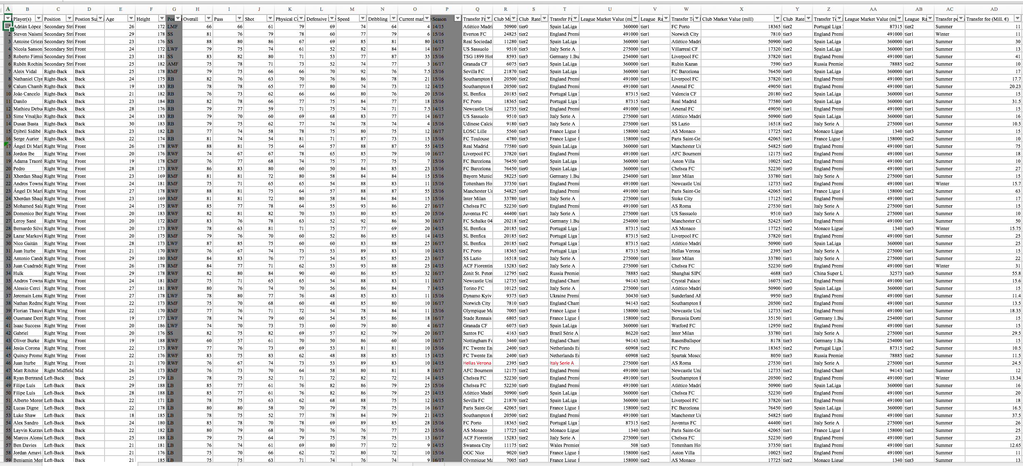
Dataset

Slide 6
Descriptive Statistic
Dependent Variable (Million)
Mean | 21.274354
Std Dev | 13.956945
Std Err Mean | 0.8139856
Upper 95% Mean | 22.876353
Lower 95% Mean | 19.672354
N | 294

Slide 7
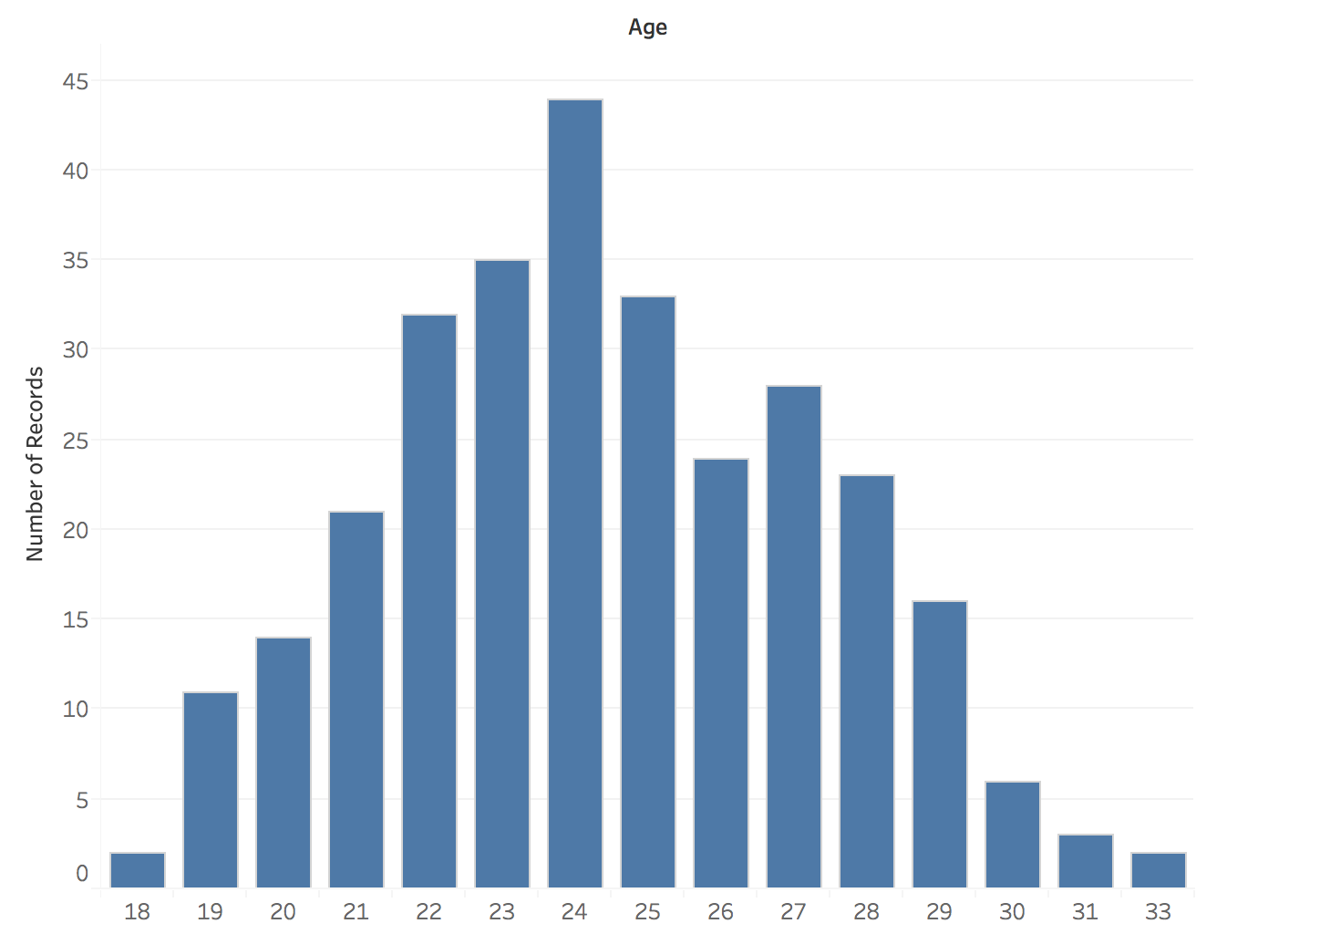
Age Distribution

Slide 8
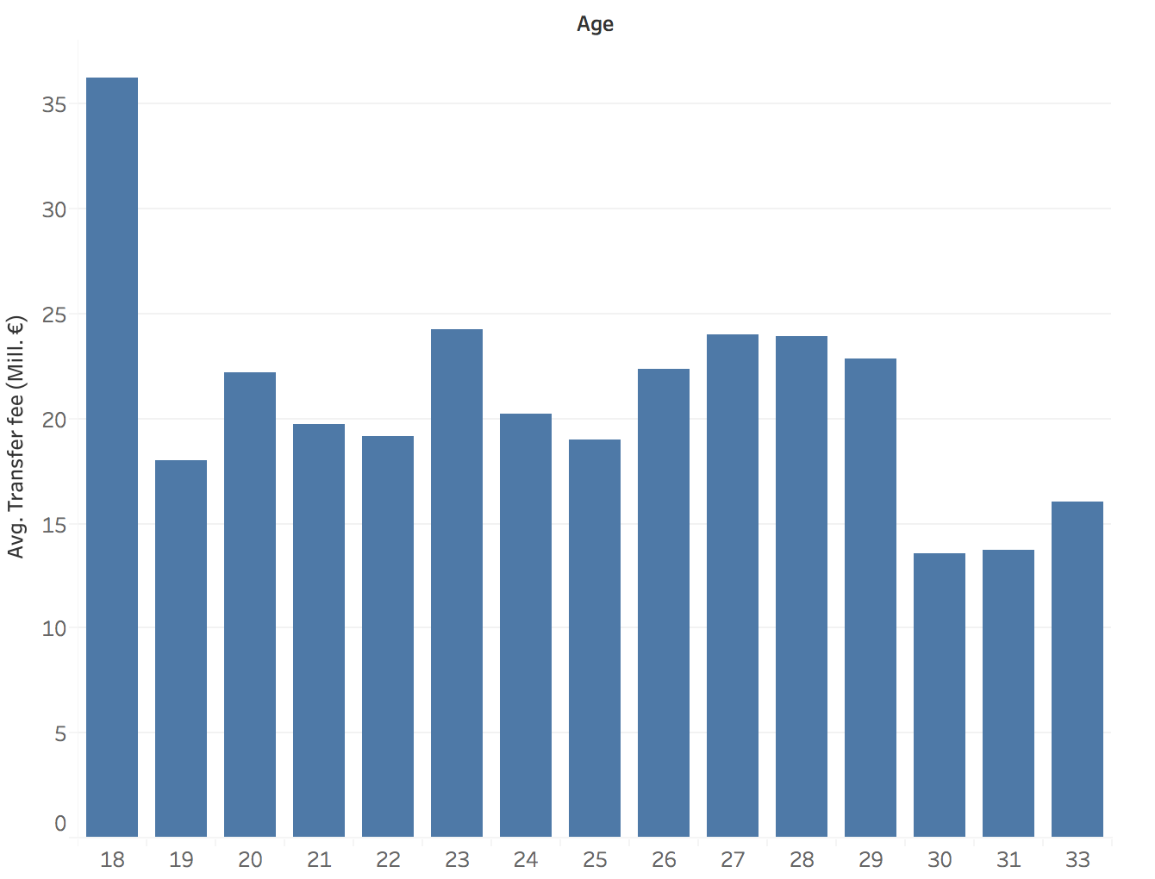
Average Transfer Fee by Age

Slide 9
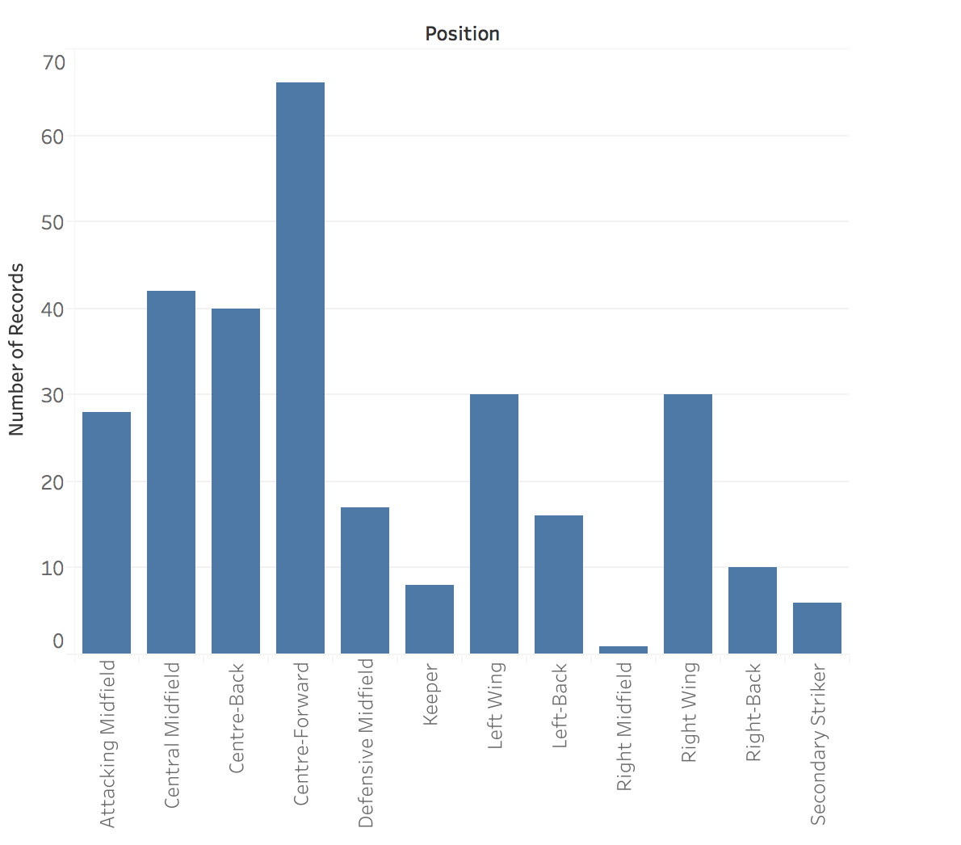
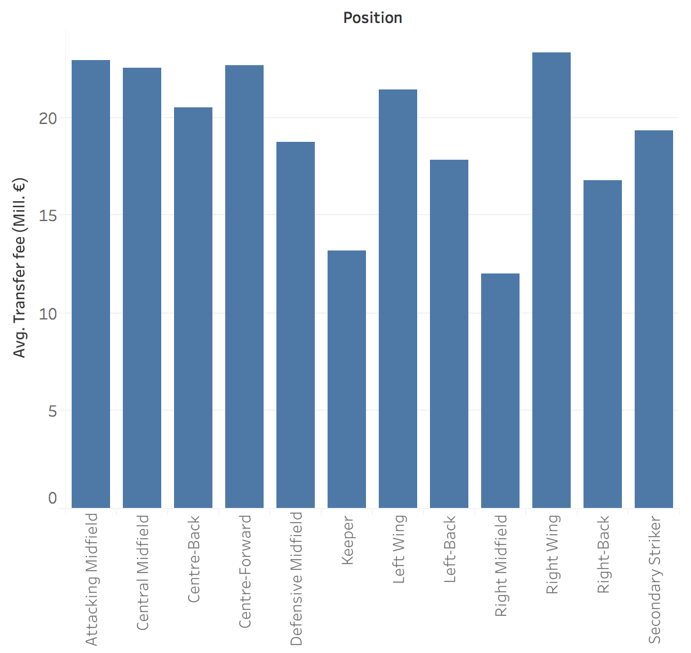
Average Transfer Fee by Position

Slide 10
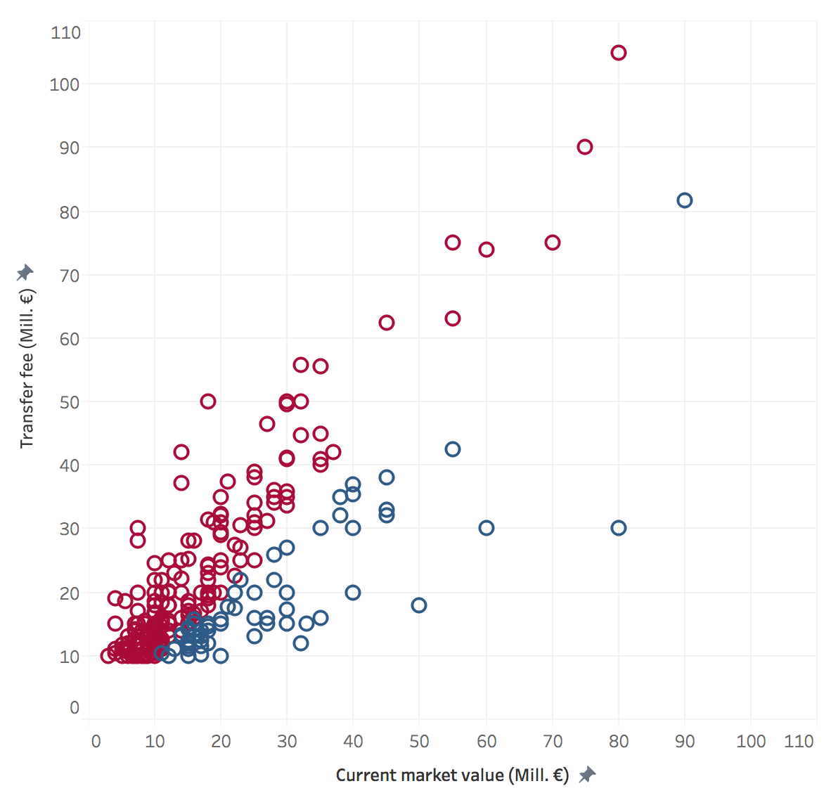
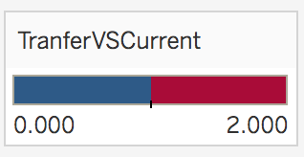
Actual Transfer fee vs. Current Players’ Market Value

Slide 11
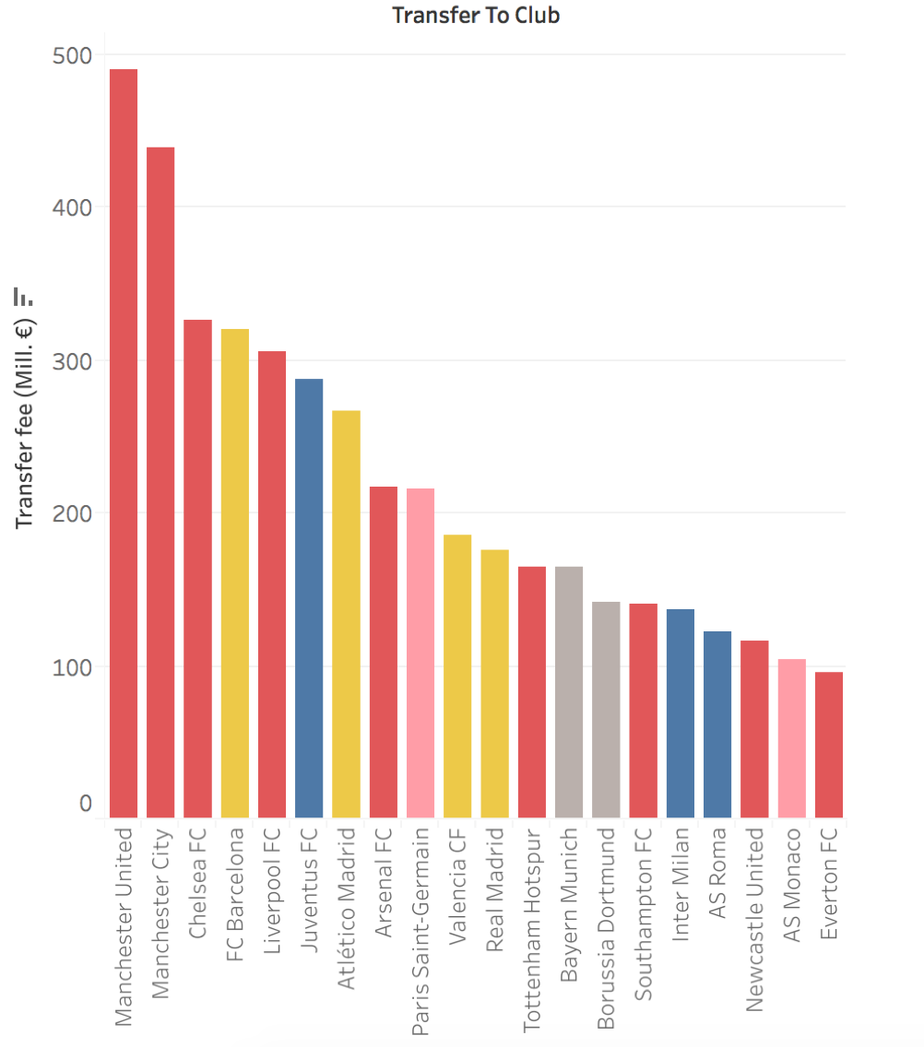
Top 20 Club

Slide 12
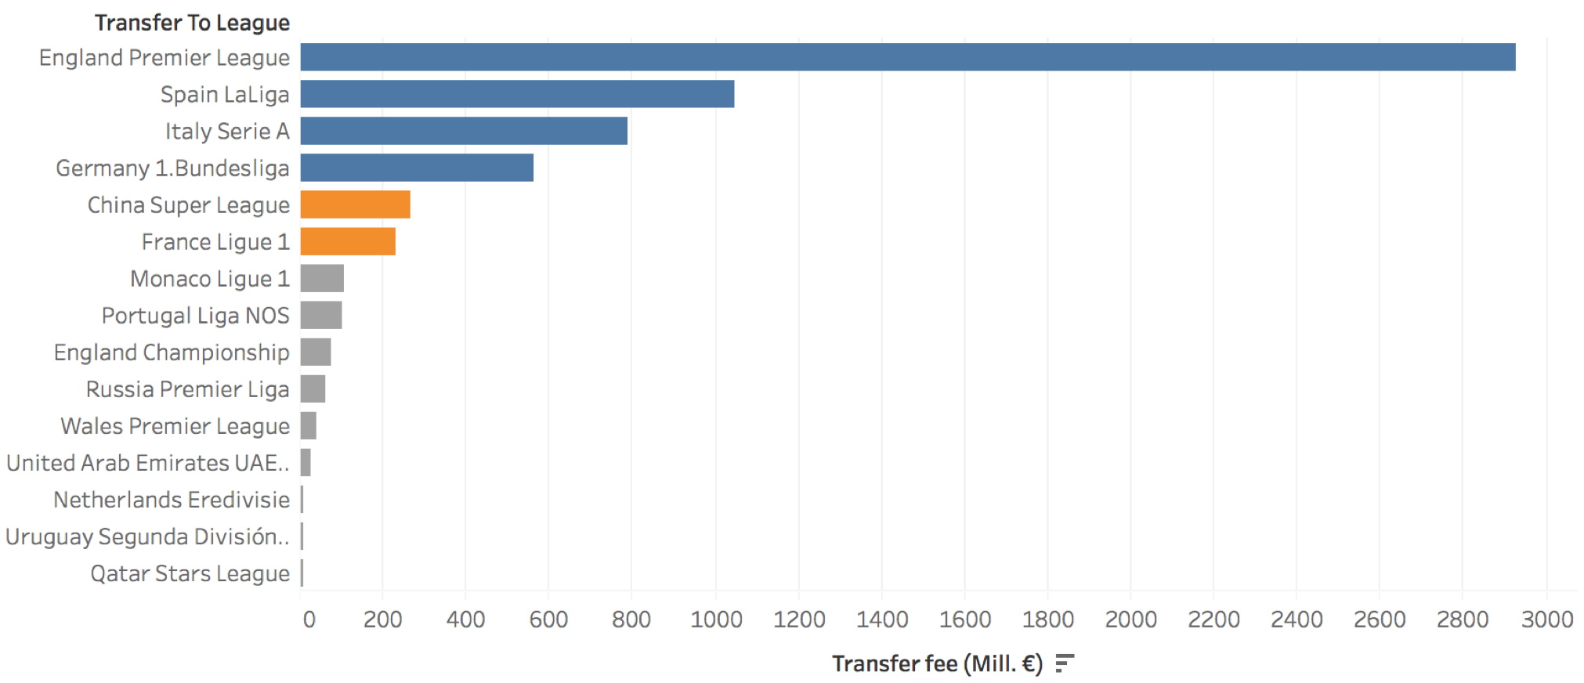
League Activity

Slide 13
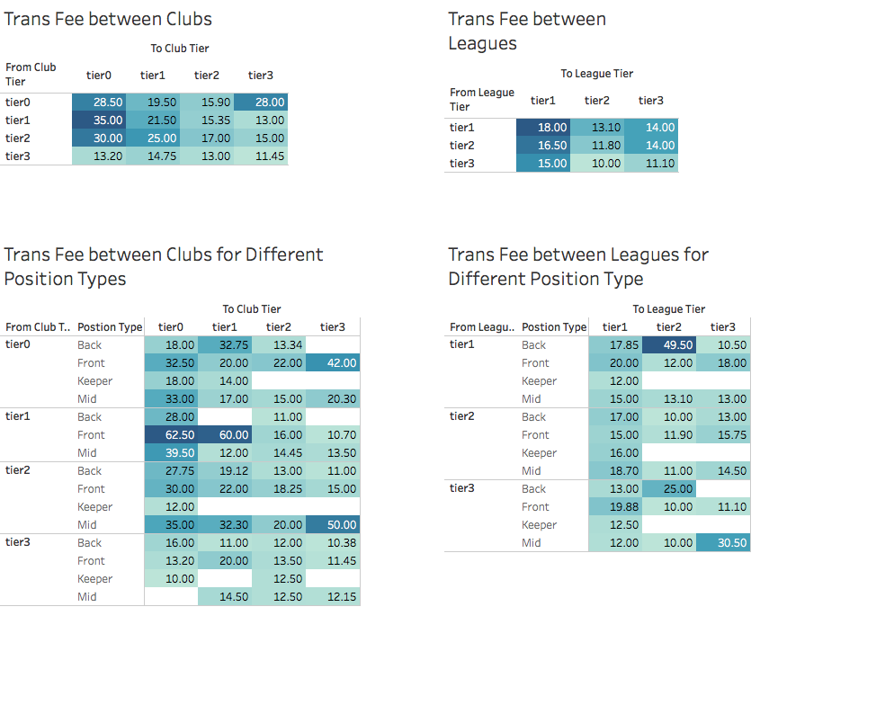

Slide 14
Our website dashboard
http://playertransferfee.weebly.com/

Slide 15
Correlation Results
Pearson Correlation Coefficients, N = 294 Prob > |r| under H0: Rho=0
Trans_Fee_Mill_Euro
Age | 0.01027 0.8608 | Speed | 0.18405 0.0015
Height | 0.01278 0.8273 | Dribbling | 0.28586 <.0001
Overall | 0.55125 <.0001 | Current_market_value_Mil_Euro | 0.80187 <.0001
Pass | 0.29033 <.0001 | From_Club_Market_Value_Mill_Euro | 0.26640 <.0001
Shot | 0.26029 <.0001 | From_League_Market_Value_Mill_Euro | 0.13276 0.0228
Physical_Contact | 0.07401 0.2057 | To_Club_Market_Value_Mill_Euro | 0.44954 <.0001
Defensive_Prowess | -0.04322 0.4603 | To_League_Market_Value_Mill_Euro | 0.14018 0.0162

Slide 16
Linear Regression
Number of Observations Read | 294
Number of Observations Used | 294
Parameter Estimates
Variable | DF | Parameter Estimate | Standard Error | t Value | Pr > |t|
Intercept | 1 | -12.67747 | 26.02213 | -0.49 | 0.6265
Age | 1 | 0.28136 | 0.20067 | 1.40 | 0.1620
Height | 1 | 0.00843 | 0.10465 | 0.08 | 0.9358
Pass | 1 | 0.13959 | 0.14591 | 0.96 | 0.3396
Shot | 1 | 0.01104 | 0.07927 | 0.14 | 0.8894
Physical_Contact | 1 | 0.24306 | 0.08522 | 2.85 | 0.0047
Defensive_Prowess | 1 | -0.01287 | 0.06057 | -0.21 | 0.8319
Speed | 1 | 0.26721 | 0.10419 | 2.56 | 0.0109
Dribbling | 1 | 0.08155 | 0.12697 | 0.64 | 0.5212
Current_market_value_Mil_Euro | 1 | 0.86148 | 0.05984 | 14.40 | <.0001
From_Club_Market_Value_Mill_Euro | 1 | 0.00001248 | 0.00003296 | 0.38 | 0.7052
From_League_Market_Value_Mill_Eu | 1 | 0.00000303 | 0.00000365 | 0.83 | 0.4070
To_Club_Market_Value_Mill_Euro | 1 | 0.00004915 | 0.00003172 | 1.55 | 0.1224
To_League_Market_Value_Mill_Euro | 1 | 0.00000102 | 0.00000319 | 0.32 | 0.7483
Overall | 1 | -0.61929 | 0.22524 | -2.75 | 0.0064
Analysis of Variance
Source | DF | Sum of Squares | Mean Square | F Value | Pr > F
Model | 14 | 38410 | 2743.55876 | 41.01 | <.0001
Error | 279 | 18665 | 66.90143
Corrected Total | 293 | 57075
Root MSE | 8.17933 | R-Square | 0.6730
Dependent Mean | 21.27435 | Adj R-Sq | 0.6566
Coeff Var | 38.44690

Slide 17
Linear Regression

Slide 18
Linear Regression

Slide 19
ANOVA
Least Squares Summary
Step | Effect Entered | Number Effects In | Number Parms In | SBC
0 | Intercept | 1 | 1 | 1554.6365
1 | Postion_Type | 2 | 4 | 1566.6363
2 | From_Club_Rate | 3 | 7 | 1531.3554
3 | From_League_Rate | 4 | 9 | 1541.8875
4 | To_Club_Rate | 5 | 12 | 1499.7745*
5 | To_League_Rate | 6 | 14 | 1509.5999
6 | Transfer_Period | 7 | 15 | 1515.1640
* Optimal Value of Criterion
Root MSE | 11.68147
Dependent Mean | 21.27435
R-Square | 0.3330
Adj R-Sq | 0.2995
AIC | 1755.91030
AICC | 1757.87419
SBC | 1515.16399
Analysis of Variance
Source | DF | Sum of Squares | Mean Square | F Value | Pr > F
Model | 14 | 19004 | 1357.41857 | 9.95 | <.0001
Error | 279 | 38071 | 136.45685
Corrected Total | 293 | 57075

Slide 20
ANOVA
Differences of From_Club_Rate Least Squares Means Adjustment for Multiple Comparisons: Tukey-Kramer
From_Club_Rate | From_Club_Rate | Estimate | Standard Error | DF | t Value | Pr > |t| | Adj P | Alpha | Lower | Upper
tier0 | tier1 | -1.7093 | 2.7002 | 279 | -0.63 | 0.5272 | 0.9213 | 0.05 | -7.0246 | 3.6060
tier0 | tier2 | 0.3893 | 2.3716 | 279 | 0.16 | 0.8697 | 0.9984 | 0.05 | -4.2792 | 5.0578
tier0 | tier3 | 7.9887 | 2.4658 | 279 | 3.24 | 0.0013 | 0.0073 | 0.05 | 3.1347 | 12.8427
tier1 | tier2 | 2.0986 | 2.3219 | 279 | 0.90 | 0.3669 | 0.8028 | 0.05 | -2.4722 | 6.6693
tier1 | tier3 | 9.6980 | 2.4106 | 279 | 4.02 | <.0001 | 0.0004 | 0.05 | 4.9527 | 14.4433
tier2 | tier3 | 7.5994 | 1.7467 | 279 | 4.35 | <.0001 | 0.0001 | 0.05 | 4.1610 | 11.0378
Differences of To_Club_Rate Least Squares Means Adjustment for Multiple Comparisons: Tukey-Kramer
To_Club_Rate | To_Club_Rate | Estimate | Standard Error | DF | t Value | Pr > |t| | Adj P | Alpha | Lower | Upper
tier0 | tier1 | 8.0723 | 2.0215 | 279 | 3.99 | <.0001 | 0.0005 | 0.05 | 4.0931 | 12.0516
tier0 | tier2 | 15.0054 | 2.0176 | 279 | 7.44 | <.0001 | <.0001 | 0.05 | 11.0337 | 18.9772
tier0 | tier3 | 16.6932 | 2.8193 | 279 | 5.92 | <.0001 | <.0001 | 0.05 | 11.1435 | 22.2430
tier1 | tier2 | 6.9331 | 1.8353 | 279 | 3.78 | 0.0002 | 0.0011 | 0.05 | 3.3204 | 10.5459
tier1 | tier3 | 8.6209 | 2.6443 | 279 | 3.26 | 0.0013 | 0.0068 | 0.05 | 3.4155 | 13.8263
tier2 | tier3 | 1.6878 | 2.3744 | 279 | 0.71 | 0.4778 | 0.8928 | 0.05 | -2.9862 | 6.3618
Better club Higher fee! But the situation doesn’t happen on the league.

Slide 21
ANOVA
Differences of Postion_Type Least Squares Means Adjustment for Multiple Comparisons: Tukey-Kramer
Postion_Type | Postion_Type | Estimate | Standard Error | DF | t Value | Pr > |t| | Adj P | Alpha | Lower | Upper
Back | Front | -6.1908 | 1.8283 | 279 | -3.39 | 0.0008 | 0.0045 | 0.05 | -9.7898 | -2.5918
Back | Keeper | 11.2587 | 4.4582 | 279 | 2.53 | 0.0121 | 0.0582 | 0.05 | 2.4828 | 20.0347
Back | Mid | -5.1041 | 1.9498 | 279 | -2.62 | 0.0093 | 0.0458 | 0.05 | -8.9422 | -1.2660
Front | Keeper | 17.4495 | 4.3805 | 279 | 3.98 | <.0001 | 0.0005 | 0.05 | 8.8264 | 26.0726
Front | Mid | 1.0866 | 1.6253 | 279 | 0.67 | 0.5043 | 0.9088 | 0.05 | -2.1127 | 4.2860
Keeper | Mid | -16.3629 | 4.4483 | 279 | -3.68 | 0.0003 | 0.0016 | 0.05 | -25.1194 | -7.6063
Keeper < Back < Front/Mid

Slide 22
ANOVA

Slide 23
ANOVA - Cross
Least Squares Summary
Step | Effect Entered | Number Effects In | Number Parms In | SBC
0 | Intercept | 1 | 1 | 1554.6365*
1 | Postion_T*From_Club_ | 2 | 15 | 1564.8823
2 | Postion_T*From_Leagu | 3 | 23 | 1608.5496
3 | From_Club*To_Club_Ra | 4 | 35 | 1583.3549
4 | From_Leag*To_League_ | 5 | 41 | 1612.7048
* Optimal Value of Criterion
Analysis of Variance
Source | DF | Sum of Squares | Mean Square | F Value | Pr > F
Model | 40 | 24983 | 624.58281 | 4.92 | <.0001
Error | 253 | 32092 | 126.84588
Corrected Total | 293 | 57075
Root MSE | 11.26259
Dependent Mean | 21.27435
R-Square | 0.4377
Adj R-Sq | 0.3488
AIC | 1757.67807
AICC | 1772.06851
SBC | 1612.70484

Slide 24
ANOVA - Cross
Differences of Postion_T*From_Club_ Least Squares Means
Adjustment for Multiple Comparisons: Tukey-Kramer
Postion_Type | From_Club_Rate | Postion_Type | From_Club_Rate | Estimate | Standard Error | DF | t Value | Pr > |t| | Adj P
Back | tier1 | Front | tier0 | -17.653 | 5.9165 | 253 | -2.98 | 0.0031 | 0.1673
Back | tier1 | Front | tier1 | -21.5898 | 5.8646 | 253 | -3.68 | 0.0003 | 0.022
Back | tier1 | Front | tier2 | -11.2353 | 5.3063 | 253 | -2.12 | 0.0352 | 0.7222
Back | tier1 | Mid | tier1 | -13.5835 | 5.8246 | 253 | -2.33 | 0.0205 | 0.5677
Back | tier1 | Mid | tier2 | -18.2974 | 5.5346 | 253 | -3.31 | 0.0011 | 0.0712
Back | tier2 | Back | tier3 | 9.6968 | 3.5538 | 253 | 2.73 | 0.0068 | 0.294
Back | tier2 | Front | tier0 | -9.0123 | 4.2066 | 253 | -2.14 | 0.0331 | 0.7051
Back | tier2 | Front | tier1 | -12.9492 | 4.2583 | 253 | -3.04 | 0.0026 | 0.1454
Back | tier2 | Mid | tier2 | -9.6567 | 3.2664 | 253 | -2.96 | 0.0034 | 0.1786
Back | tier2 | Mid | tier3 | 6.8551 | 3.4401 | 253 | 1.99 | 0.0474 | 0.8009
Back | tier3 | Front | tier0 | -18.7091 | 4.3668 | 253 | -4.28 | <.0001 | 0.0024
Back | tier3 | Front | tier1 | -22.646 | 4.3891 | 253 | -5.16 | <.0001 | <.0001
Back | tier3 | Front | tier2 | -12.2914 | 3.2957 | 253 | -3.73 | 0.0002 | 0.0187
Back | tier3 | Mid | tier0 | -11.7153 | 4.8849 | 253 | -2.4 | 0.0172 | 0.5185
Back | tier3 | Mid | tier1 | -14.6396 | 4.3057 | 253 | -3.4 | 0.0008 | 0.054
Back | tier3 | Mid | tier2 | -19.3536 | 3.6555 | 253 | -5.29 | <.0001 | <.0001

Slide 25
ANOVA - Cross
Differences of Postion_T*From_Club_ Least Squares Means
Adjustment for Multiple Comparisons: Tukey-Kramer
Postion_Type | From_Club_Rate | Postion_Type | From_Club_Rate | Estimate | Standard Error | DF | t Value | Pr > |t| | Adj P
Front | tier0 | Front | tier3 | 13.8386 | 3.925 | 253 | 3.53 | 0.0005 | 0.0366
Front | tier0 | Keeper | tier2 | 22.2613 | 8.9013 | 253 | 2.5 | 0.013 | 0.4437
Front | tier0 | Mid | tier3 | 15.8674 | 4.2524 | 253 | 3.73 | 0.0002 | 0.0186
Front | tier1 | Front | tier2 | 10.3546 | 3.7375 | 253 | 2.77 | 0.006 | 0.2699
Front | tier1 | Front | tier3 | 17.7754 | 3.9505 | 253 | 4.5 | <.0001 | 0.001
Front | tier1 | Keeper | tier2 | 26.1981 | 8.9341 | 253 | 2.93 | 0.0037 | 0.1889
Front | tier1 | Keeper | tier3 | 23.9699 | 10.3088 | 253 | 2.33 | 0.0209 | 0.5728
Front | tier1 | Mid | tier0 | 10.9307 | 5.3273 | 253 | 2.05 | 0.0412 | 0.765
Front | tier1 | Mid | tier3 | 19.8043 | 4.2919 | 253 | 4.61 | <.0001 | 0.0006
Front | tier2 | Front | tier3 | 7.4209 | 2.7012 | 253 | 2.75 | 0.0064 | 0.2831
Front | tier2 | Mid | tier2 | -7.0621 | 3.0147 | 253 | -2.34 | 0.0199 | 0.5599
Front | tier2 | Mid | tier3 | 9.4497 | 3.2013 | 253 | 2.95 | 0.0035 | 0.1805
Front | tier3 | Mid | tier1 | -9.7691 | 3.8716 | 253 | -2.52 | 0.0122 | 0.4278
Front | tier3 | Mid | tier2 | -14.483 | 3.1353 | 253 | -4.62 | <.0001 | 0.0006

Slide 26
ANOVA - Cross
Differences of Postion_T*From_Club_ Least Squares Means
Adjustment for Multiple Comparisons: Tukey-Kramer
Postion_Type | From_Club_Rate | Postion_Type | From_Club_Rate | Estimate | Standard Error | DF | t Value | Pr > |t| | Adj P
Mid | tier0 | Mid | tier1 | -2.9243 | 4.3793 | 253 | -0.67 | 0.5049 | 1.0000
Mid | tier0 | Mid | tier2 | -7.6383 | 4.5529 | 253 | -1.68 | 0.0946 | 0.9380
Mid | tier0 | Mid | tier3 | 8.8735 | 4.6312 | 253 | 1.92 | 0.0565 | 0.8430
Mid | tier1 | Mid | tier2 | -4.7140 | 3.9434 | 253 | -1.20 | 0.2330 | 0.9972
Mid | tier1 | Mid | tier3 | 11.7979 | 4.0209 | 253 | 2.93 | 0.0037 | 0.1882
Mid | tier2 | Mid | tier3 | 16.5118 | 3.4055 | 253 | 4.85 | <.0001 | 0.0002

Slide 27
ANOVA - Cross
Differences of Postion_T*From_Club_ Least Squares Means
Adjustment for Multiple Comparisons: Tukey-Kramer
Postion_Type | From_Club_Rate | Postion_Type | From_Club_Rate | Estimate | Standard Error | DF | t Value | Pr > |t| | Adj P
Keeper | tier0 | Keeper | tier2 | 9.3697 | 10.7355 | 253 | 0.87 | 0.3836 | 0.9999
Keeper | tier0 | Keeper | tier3 | 7.1415 | 14.5060 | 253 | 0.49 | 0.6229 | 1.0000
Keeper | tier0 | Mid | tier0 | -5.8977 | 11.5811 | 253 | -0.51 | 0.6110 | 1.0000
Keeper | tier0 | Mid | tier1 | -8.8220 | 11.3923 | 253 | -0.77 | 0.4394 | 1.0000
Keeper | tier0 | Mid | tier2 | -13.5360 | 11.2110 | 253 | -1.21 | 0.2284 | 0.9969
Keeper | tier0 | Mid | tier3 | 2.9758 | 11.0098 | 253 | 0.27 | 0.7872 | 1.0000
Keeper | tier2 | Keeper | tier3 | -2.2282 | 13.6763 | 253 | -0.16 | 0.8707 | 1.0000
Keeper | tier2 | Mid | tier0 | -15.2674 | 9.2353 | 253 | -1.65 | 0.0995 | 0.9447
Keeper | tier2 | Mid | tier1 | -18.1917 | 8.9451 | 253 | -2.03 | 0.0430 | 0.7763
Keeper | tier2 | Mid | tier2 | -22.9057 | 8.4732 | 253 | -2.70 | 0.0073 | 0.3091
Keeper | tier2 | Mid | tier3 | -6.3938 | 8.3512 | 253 | -0.77 | 0.4446 | 1.0000
Keeper | tier3 | Mid | tier0 | -13.0392 | 10.5293 | 253 | -1.24 | 0.2167 | 0.9960
Keeper | tier3 | Mid | tier1 | -15.9635 | 10.2729 | 253 | -1.55 | 0.1214 | 0.9665
Keeper | tier3 | Mid | tier2 | -20.6775 | 10.0238 | 253 | -2.06 | 0.0401 | 0.7580
Keeper | tier3 | Mid | tier3 | -4.1656 | 10.2372 | 253 | -0.41 | 0.6844 | 1.0000

Slide 28
Differences of Postion_T*From_Leagu Least Squares Means Adjustment for Multiple Comparisons: Tukey-Kramer
Postion_Type | From_League_Rate | Postion_Type | From_League_Rate | Estimate | Standard Error | DF | t Value | Pr > |t|
Back | tier1 | Back | tier2 | 2.5976 | 4.0910 | 253 | 0.63 | 0.5260
Back | tier1 | Back | tier3 | -0.2776 | 5.5149 | 253 | -0.05 | 0.9599
Back | tier1 | Front | tier1 | -8.0842 | 2.5416 | 253 | -3.18 | 0.0017
Back | tier1 | Front | tier2 | -9.7575 | 3.7844 | 253 | -2.58 | 0.0105
Back | tier1 | Front | tier3 | -8.4746 | 4.7706 | 253 | -1.78 | 0.0769
Back | tier1 | Keeper | tier1 | Non-est | . | . | . | .
Back | tier1 | Keeper | tier2 | Non-est | . | . | . | .
Back | tier1 | Keeper | tier3 | Non-est | . | . | . | .
Back | tier1 | Mid | tier1 | -4.3535 | 2.7123 | 253 | -1.61 | 0.1097
Back | tier1 | Mid | tier2 | -5.7253 | 4.1454 | 253 | -1.38 | 0.1685
Back | tier1 | Mid | tier3 | -8.7622 | 5.1346 | 253 | -1.71 | 0.0891
Back | tier2 | Back | tier3 | -2.8752 | 5.4365 | 253 | -0.53 | 0.5974
Back | tier2 | Front | tier1 | -10.6818 | 4.0766 | 253 | -2.62 | 0.0093
Back | tier2 | Front | tier2 | -12.3551 | 3.8494 | 253 | -3.21 | 0.0015
Back | tier2 | Front | tier3 | -11.0722 | 5.2531 | 253 | -2.11 | 0.0360
Back | tier2 | Keeper | tier1 | Non-est | . | . | . | .
Back | tier2 | Keeper | tier2 | Non-est | . | . | . | .
Back | tier2 | Keeper | tier3 | Non-est | . | . | . | .
Back | tier2 | Mid | tier1 | -6.9511 | 4.0995 | 253 | -1.70 | 0.0912
Back | tier2 | Mid | tier2 | -8.3229 | 4.1762 | 253 | -1.99 | 0.0473
Back | tier2 | Mid | tier3 | -11.3599 | 5.5888 | 253 | -2.03 | 0.0431
Back | tier3 | Front | tier1 | -7.8066 | 5.4921 | 253 | -1.42 | 0.1564
Back | tier3 | Front | tier2 | -9.4799 | 5.5896 | 253 | -1.70 | 0.0911
Back | tier3 | Front | tier3 | -8.1969 | 5.4114 | 253 | -1.51 | 0.1311
Back | tier3 | Keeper | tier1 | Non-est | . | . | . | .
Back | tier3 | Keeper | tier2 | Non-est | . | . | . | .
Back | tier3 | Keeper | tier3 | Non-est | . | . | . | .
Back | tier3 | Mid | tier1 | -4.0759 | 5.5521 | 253 | -0.73 | 0.4636
Back | tier3 | Mid | tier2 | -5.4476 | 5.8301 | 253 | -0.93 | 0.3510
Back | tier3 | Mid | tier3 | -8.4846 | 5.8529 | 253 | -1.45 | 0.1484

Slide 29
ANOVA - Cross
Differences of From_Club*To_Club_Ra Least Squares Means Adjustment for Multiple Comparisons: Tukey-Kramer
From_Club_Rate | To_Club_Rate | From_Club_Rate | To_Club_Rate | Estimate | Standard Error | DF | t Value | Pr > |t| | Adj P
tier0 | tier0 | tier0 | tier1 | 9.6675 | 4.8049 | 253 | 2.01 | 0.0453 | 0.8164
tier0 | tier0 | tier0 | tier2 | 15.5409 | 5.0817 | 253 | 3.06 | 0.0025 | 0.1532
tier0 | tier0 | tier0 | tier3 | 4.6190 | 8.1320 | 253 | 0.57 | 0.5705 | 1.0000
tier0 | tier0 | tier1 | tier0 | Non-est | . | . | . | . | .
tier0 | tier0 | tier1 | tier1 | Non-est | . | . | . | . | .
tier0 | tier0 | tier1 | tier2 | Non-est | . | . | . | . | .
tier0 | tier0 | tier1 | tier3 | Non-est | . | . | . | . | .
tier0 | tier0 | tier2 | tier0 | 1.8061 | 4.4013 | 253 | 0.41 | 0.6819 | 1.0000
tier0 | tier0 | tier2 | tier1 | 8.5131 | 4.7056 | 253 | 1.81 | 0.0716 | 0.9111
tier0 | tier0 | tier2 | tier2 | 15.5319 | 4.8520 | 253 | 3.20 | 0.0015 | 0.1057
tier0 | tier0 | tier2 | tier3 | 12.0111 | 6.1999 | 253 | 1.94 | 0.0538 | 0.8560
tier0 | tier0 | tier3 | tier0 | 13.5513 | 5.9331 | 253 | 2.28 | 0.0232 | 0.6359
tier0 | tier0 | tier3 | tier1 | 14.4451 | 5.4115 | 253 | 2.67 | 0.0081 | 0.3565
tier0 | tier0 | tier3 | tier2 | 18.9232 | 5.3056 | 253 | 3.57 | 0.0004 | 0.0359
tier0 | tier0 | tier3 | tier3 | 22.3439 | 5.8073 | 253 | 3.85 | 0.0002 | 0.0140
tier0 | tier1 | tier0 | tier2 | 5.8734 | 4.5921 | 253 | 1.28 | 0.2021 | 0.9963
tier0 | tier1 | tier0 | tier3 | -5.0485 | 8.0138 | 253 | -0.63 | 0.5293 | 1.0000

Slide 30
ANOVA - Cross
Differences of From_Club*To_Club_Ra Least Squares Means Adjustment for Multiple Comparisons: Tukey-Kramer
From_Club_Rate | To_Club_Rate | From_Club_Rate | To_Club_Rate | Estimate | Standard Error | DF | t Value | Pr > |t| | Adj P
tier0 | tier0 | tier0 | tier1 | 9.6675 | 4.8049 | 253 | 2.01 | 0.0453 | 0.8164
tier0 | tier0 | tier0 | tier2 | 15.5409 | 5.0817 | 253 | 3.06 | 0.0025 | 0.1532
tier0 | tier0 | tier0 | tier3 | 4.6190 | 8.1320 | 253 | 0.57 | 0.5705 | 1.0000
tier0 | tier0 | tier1 | tier0 | Non-est | . | . | . | . | .
tier0 | tier0 | tier1 | tier1 | Non-est | . | . | . | . | .
tier0 | tier0 | tier1 | tier2 | Non-est | . | . | . | . | .
tier0 | tier0 | tier1 | tier3 | Non-est | . | . | . | . | .
tier0 | tier0 | tier2 | tier0 | 1.8061 | 4.4013 | 253 | 0.41 | 0.6819 | 1.0000
tier0 | tier0 | tier2 | tier1 | 8.5131 | 4.7056 | 253 | 1.81 | 0.0716 | 0.9111
tier0 | tier0 | tier2 | tier2 | 15.5319 | 4.8520 | 253 | 3.20 | 0.0015 | 0.1057
tier0 | tier0 | tier2 | tier3 | 12.0111 | 6.1999 | 253 | 1.94 | 0.0538 | 0.8560
tier0 | tier0 | tier3 | tier0 | 13.5513 | 5.9331 | 253 | 2.28 | 0.0232 | 0.6359
tier0 | tier0 | tier3 | tier1 | 14.4451 | 5.4115 | 253 | 2.67 | 0.0081 | 0.3565
tier0 | tier0 | tier3 | tier2 | 18.9232 | 5.3056 | 253 | 3.57 | 0.0004 | 0.0359
tier0 | tier0 | tier3 | tier3 | 22.3439 | 5.8073 | 253 | 3.85 | 0.0002 | 0.0140
tier0 | tier1 | tier0 | tier2 | 5.8734 | 4.5921 | 253 | 1.28 | 0.2021 | 0.9963
tier0 | tier1 | tier0 | tier3 | -5.0485 | 8.0138 | 253 | -0.63 | 0.5293 | 1.0000

Slide 31
Differences of From_Club*To_Club_Ra Least Squares Means Adjustment for Multiple Comparisons: Tukey-Kramer
From_Club_Rate | To_Club_Rate | From_Club_Rate | To_Club_Rate | Estimate | Standard Error | DF | t Value | Pr > |t| | Adj P
tier1 | tier0 | tier1 | tier1 | 17.8607 | 6.0108 | 253 | 2.97 | 0.0032 | 0.1889
tier1 | tier0 | tier1 | tier2 | 32.0490 | 4.5233 | 253 | 7.09 | <.0001 | <.0001
tier1 | tier0 | tier1 | tier3 | 37.2916 | 6.0597 | 253 | 6.15 | <.0001 | <.0001
tier1 | tier0 | tier2 | tier0 | Non-est | . | . | . | . | .
tier1 | tier0 | tier2 | tier1 | Non-est | . | . | . | . | .
tier1 | tier0 | tier2 | tier2 | Non-est | . | . | . | . | .
tier1 | tier0 | tier2 | tier3 | Non-est | . | . | . | . | .
tier1 | tier0 | tier3 | tier0 | Non-est | . | . | . | . | .
tier1 | tier0 | tier3 | tier1 | Non-est | . | . | . | . | .
tier1 | tier0 | tier3 | tier2 | Non-est | . | . | . | . | .
tier1 | tier0 | tier3 | tier3 | Non-est | . | . | . | . | .
tier1 | tier1 | tier1 | tier2 | 14.1883 | 5.5549 | 253 | 2.55 | 0.0112 | 0.4357
tier1 | tier1 | tier1 | tier3 | 19.4309 | 6.5377 | 253 | 2.97 | 0.0032 | 0.1886
tier1 | tier1 | tier2 | tier0 | Non-est | . | . | . | . | .
tier1 | tier1 | tier2 | tier1 | Non-est | . | . | . | . | .
tier1 | tier1 | tier2 | tier2 | Non-est | . | . | . | . | .
tier1 | tier1 | tier2 | tier3 | Non-est | . | . | . | . | .
tier1 | tier1 | tier3 | tier0 | Non-est | . | . | . | . | .
tier1 | tier1 | tier3 | tier1 | Non-est | . | . | . | . | .
tier1 | tier1 | tier3 | tier2 | Non-est | . | . | . | . | .
tier1 | tier1 | tier3 | tier3 | Non-est | . | . | . | . | .
tier1 | tier2 | tier1 | tier3 | 5.2426 | 5.3691 | 253 | 0.98 | 0.3298 | 0.9998
tier1 | tier2 | tier2 | tier0 | Non-est | . | . | . | . | .
tier1 | tier2 | tier2 | tier1 | Non-est | . | . | . | . | .
tier1 | tier2 | tier2 | tier2 | Non-est | . | . | . | . | .
tier1 | tier2 | tier2 | tier3 | Non-est | . | . | . | . | .

Slide 32
Differences of From_Club*To_Club_Ra Least Squares Means Adjustment for Multiple Comparisons: Tukey-Kramer
From_Club_Rate | To_Club_Rate | From_Club_Rate | To_Club_Rate | Estimate | Standard Error | DF | t Value | Pr > |t| | Adj P
tier1 | tier2 | tier3 | tier0 | Non-est | . | . | . | . | .
tier1 | tier2 | tier3 | tier1 | Non-est | . | . | . | . | .
tier1 | tier2 | tier3 | tier2 | Non-est | . | . | . | . | .
tier1 | tier2 | tier3 | tier3 | Non-est | . | . | . | . | .
tier1 | tier3 | tier2 | tier0 | Non-est | . | . | . | . | .
tier1 | tier3 | tier2 | tier1 | Non-est | . | . | . | . | .
tier1 | tier3 | tier2 | tier2 | Non-est | . | . | . | . | .
tier1 | tier3 | tier2 | tier3 | Non-est | . | . | . | . | .
tier1 | tier3 | tier3 | tier0 | Non-est | . | . | . | . | .
tier1 | tier3 | tier3 | tier1 | Non-est | . | . | . | . | .
tier1 | tier3 | tier3 | tier2 | Non-est | . | . | . | . | .
tier1 | tier3 | tier3 | tier3 | Non-est | . | . | . | . | .

Slide 33
Differences of From_Club*To_Club_Ra Least Squares Means Adjustment for Multiple Comparisons: Tukey-Kramer
From_Club_Rate | To_Club_Rate | From_Club_Rate | To_Club_Rate | Estimate | Standard Error | DF | t Value | Pr > |t| | Adj P
tier2 | tier0 | tier2 | tier1 | 6.7070 | 2.8612 | 253 | 2.34 | 0.0198 | 0.5913
tier2 | tier0 | tier2 | tier2 | 13.7259 | 2.9729 | 253 | 4.62 | <.0001 | 0.0007
tier2 | tier0 | tier2 | tier3 | 10.2050 | 4.9376 | 253 | 2.07 | 0.0398 | 0.7842
tier2 | tier0 | tier3 | tier0 | 11.7452 | 5.0256 | 253 | 2.34 | 0.0202 | 0.5965
tier2 | tier0 | tier3 | tier1 | 12.6390 | 4.3693 | 253 | 2.89 | 0.0042 | 0.2262
tier2 | tier0 | tier3 | tier2 | 17.1172 | 4.1839 | 253 | 4.09 | <.0001 | 0.0057
tier2 | tier0 | tier3 | tier3 | 20.5378 | 4.7957 | 253 | 4.28 | <.0001 | 0.0027
tier2 | tier1 | tier2 | tier2 | 7.0189 | 3.1048 | 253 | 2.26 | 0.0246 | 0.6530
tier2 | tier1 | tier2 | tier3 | 3.4980 | 4.9855 | 253 | 0.70 | 0.4835 | 1.0000
tier2 | tier1 | tier3 | tier0 | 5.0382 | 5.2931 | 253 | 0.95 | 0.3421 | 0.9999
tier2 | tier1 | tier3 | tier1 | 5.9321 | 4.6747 | 253 | 1.27 | 0.2056 | 0.9966
tier2 | tier1 | tier3 | tier2 | 10.4102 | 4.4963 | 253 | 2.32 | 0.0214 | 0.6128
tier2 | tier1 | tier3 | tier3 | 13.8308 | 5.0411 | 253 | 2.74 | 0.0065 | 0.3093
tier2 | tier2 | tier2 | tier3 | -3.5209 | 5.0153 | 253 | -0.70 | 0.4833 | 1.0000
tier2 | tier2 | tier3 | tier0 | -1.9807 | 5.3986 | 253 | -0.37 | 0.7140 | 1.0000
tier2 | tier2 | tier3 | tier1 | -1.0868 | 4.7167 | 253 | -0.23 | 0.8180 | 1.0000

Slide 34
Differences of From_Club*To_Club_Ra Least Squares Means Adjustment for Multiple Comparisons: Tukey-Kramer
From_Club_Rate | To_Club_Rate | From_Club_Rate | To_Club_Rate | Estimate | Standard Error | DF | t Value | Pr > |t| | Adj P
tier2 | tier2 | tier3 | tier2 | 3.3913 | 4.4834 | 253 | 0.76 | 0.4501 | 1.0000
tier2 | tier2 | tier3 | tier3 | 6.8119 | 5.0138 | 253 | 1.36 | 0.1755 | 0.9931
tier2 | tier3 | tier3 | tier0 | 1.5402 | 6.6655 | 253 | 0.23 | 0.8174 | 1.0000
tier2 | tier3 | tier3 | tier1 | 2.4340 | 6.1597 | 253 | 0.40 | 0.6931 | 1.0000
tier2 | tier3 | tier3 | tier2 | 6.9121 | 5.9863 | 253 | 1.15 | 0.2493 | 0.9988
tier2 | tier3 | tier3 | tier3 | 10.3328 | 6.2790 | 253 | 1.65 | 0.1011 | 0.9582
tier3 | tier0 | tier3 | tier1 | 0.8938 | 5.3124 | 253 | 0.17 | 0.8665 | 1.0000
tier3 | tier0 | tier3 | tier2 | 5.3719 | 5.1598 | 253 | 1.04 | 0.2988 | 0.9996
tier3 | tier0 | tier3 | tier3 | 8.7926 | 5.6442 | 253 | 1.56 | 0.1205 | 0.9741
tier3 | tier1 | tier3 | tier2 | 4.4781 | 2.7271 | 253 | 1.64 | 0.1018 | 0.9589
tier3 | tier1 | tier3 | tier3 | 7.8988 | 3.5506 | 253 | 2.22 | 0.0270 | 0.6790
tier3 | tier2 | tier3 | tier3 | 3.4206 | 3.1504 | 253 | 1.09 | 0.2786 | 0.9994

Slide 35
Binary Logistic Regression
Testing Global Null Hypothesis: BETA=0
Test | Chi-Square | DF | Pr > ChiSq
Likelihood Ratio | 214.2210 | 30 | <.0001
Score | 165.3014 | 30 | <.0001
Wald | 47.1322 | 30 | 0.0242
Type 3 Analysis of Effects
Effect | DF | Wald Chi-Square | Pr > ChiSq
Age | 1 | 0.1857 | 0.6665
Height | 1 | 0.3732 | 0.5412
Overall | 1 | 0.0036 | 0.9519
Pass | 1 | 0.0333 | 0.8552
Shot | 1 | 0.0581 | 0.8095
Pysical_Contact | 1 | 1.7091 | 0.1911
Defensive_Prowess | 1 | 3.6308 | 0.0567
Speed | 1 | 0.1723 | 0.6781
Dribbling | 1 | 1.5964 | 0.2064
Current_market_value | 1 | 21.1988 | <.0001
From_Club_Market_Val | 1 | 1.7131 | 0.1906
From_League_Market_V | 1 | 2.9174 | 0.0876
To_Club_Market_Value | 1 | 0.0691 | 0.7927
To_League_Market_Val | 1 | 0.3977 | 0.5283
Postion_Type | 3 | 1.3840 | 0.7093
Season | 2 | 3.6065 | 0.1648
From_Club_Rate | 3 | 10.6322 | 0.0139
From_League_Rate | 2 | 0.8368 | 0.6581
To_Club_Rate | 3 | 2.7438 | 0.4328
To_League_Rate | 2 | 1.2104 | 0.5460
Transfer_Period | 1 | 3.8796 | 0.0489

Slide 36
Binary Logistic Regression
Analysis of Maximum Likelihood Estimates
Parameter |  | DF | Estimate | Standard Error | Wald Chi-Square | Pr > ChiSq
Intercept |  | 1 | -8.1728 | 18.5328 | 0.1945 | 0.6592
Age |  | 1 | -0.0589 | 0.1368 | 0.1857 | 0.6665
Height |  | 1 | 0.0417 | 0.0683 | 0.3732 | 0.5412
Overall |  | 1 | 0.0127 | 0.2103 | 0.0036 | 0.9519
Pass |  | 1 | -0.0186 | 0.1017 | 0.0333 | 0.8552
Shot |  | 1 | 0.0130 | 0.0539 | 0.0581 | 0.8095
Pysical_Contact |  | 1 | 0.0700 | 0.0536 | 1.7091 | 0.1911
Defensive_Prowess |  | 1 | -0.0961 | 0.0504 | 3.6308 | 0.0567
Speed |  | 1 | 0.0307 | 0.0739 | 0.1723 | 0.6781
Dribbling |  | 1 | -0.1072 | 0.0849 | 1.5964 | 0.2064
Postion_Type | Back | 1 | -1.1223 | 1.1228 | 0.9990 | 0.3175
Postion_Type | Front | 1 | -0.8590 | 1.0863 | 0.6253 | 0.4291
Postion_Type | Keeper | 1 | -19.6904 | 630.4 | 0.0010 | 0.9751
Postion_Type | Mid | 0 | 0 | . | . | .
Season | 14/15 | 1 | -0.6988 | 0.8588 | 0.6622 | 0.4158
Season | 15/16 | 1 | 0.8942 | 0.7858 | 1.2949 | 0.2551
Season | 16/17 | 0 | 0 | . | . | .

Slide 37
Binary Logistic Regression
Analysis of Maximum Likelihood Estimates
Parameter |  | DF | Estimate | Standard Error | Wald Chi-Square | Pr > ChiSq
From_Club_Rate | tier0 | 1 | 4.0778 | 3.0781 | 1.7551 | 0.1852
From_Club_Rate | tier1 | 1 | 3.9674 | 2.1382 | 3.4428 | 0.0635
From_Club_Rate | tier2 | 1 | 3.7980 | 1.2540 | 9.1735 | 0.0025
From_Club_Rate | tier3 | 0 | 0 | . | . | .
From_League_Rate | tier1 | 1 | -1.2067 | 1.9241 | 0.3933 | 0.5306
From_League_Rate | tier2 | 1 | 0.0664 | 1.3132 | 0.0026 | 0.9597
From_League_Rate | tier3 | 0 | 0 | . | . | .
To_Club_Rate | tier0 | 1 | 2.2961 | 3.1528 | 0.5304 | 0.4665
To_Club_Rate | tier1 | 1 | 1.5255 | 2.6320 | 0.3360 | 0.5622
To_Club_Rate | tier2 | 1 | -0.4462 | 2.1259 | 0.0441 | 0.8338
To_Club_Rate | tier3 | 0 | 0 | . | . | .
To_League_Rate | tier1 | 1 | -1.6829 | 2.2722 | 0.5486 | 0.4589
To_League_Rate | tier2 | 1 | -0.0136 | 2.3456 | 0.0000 | 0.9954
To_League_Rate | tier3 | 0 | 0 | . | . | .
Transfer_Period | Summer | 1 | -2.3059 | 1.1707 | 3.8796 | 0.0489
Transfer_Period | Winter | 0 | 0 | . | . | .
Current_market_value |  | 1 | 0.2777 | 0.0603 | 21.1988 | <.0001
From_Club_Market_Val |  | 1 | -0.00008 | 0.000060 | 1.7131 | 0.1906
From_League_Market_V |  | 1 | 7.752E-6 | 4.538E-6 | 2.9174 | 0.0876
To_Club_Market_Value |  | 1 | 0.000011 | 0.000044 | 0.0691 | 0.7927
To_League_Market_Val |  | 1 | 2.027E-6 | 3.214E-6 | 0.3977 | 0.5283

Slide 38
Binary Logistic Regression

Slide 39
RPM
Selected Model | Model Node | Model Description
Y | Ensmbl | Ensemble_Champion
 | Reg3 | Backwards
 | Reg2 | Forwards
 | Reg5 | Stepwise
 | Data Role
 | TRAIN |  | VALIDATE
 | Predicted |  | Predicted
 | 0 | 1 | 0 | 1
Target | 100.00 | . | 96.52 | 3.48
0
1 | 62.50 | 37.50 | 82.35 | 17.65

Slide 40
Our website dashboard
http://playertransferfee.weebly.com/
https://analytics.google.com/analytics/web/#report/defaultid/a88363400w131237401p135126201/

Slide 41
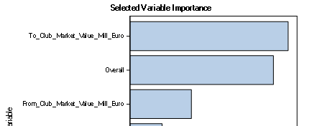
Conclusion
From RPM
The value of club that players transfer to really matters in the transferring market.
What’s more, the overall ability of players is the second important variables here.
The value of club that players transfer from also plays an important role.
These three variables really make sense when we compare our results with reality.

Slide 42
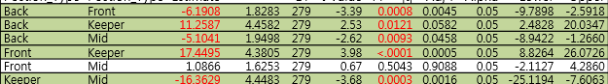
Conclusion
From Anova
Divided by position on court:
The transfer fee: Keeper < Back < Mid/Front
Some interesting result:
Front players from tier 3 clubs always need higher transferring fee than back player from tier 2 clubs.
Mid players from tier 3 clubs need higher transferring fee than back players from tier2 clubs.

